Slide 1
Data Structures and Algorithms
Lecture 5: Analysis of Algorithms
Data Science
United International College

Slide 2
Outline
Algorithm (算法)
  What is an algorithm?
  How to describe an algorithm?
Analysis of algorithms
Growth Rate and the Big-O Notation

Slide 3
What is an Algorithm?
Algorithm: a clearly specified set of simple instructions to be followed to solve a problem
  Takes a set of values as input (输入).
  Produces a value or set of values as output (输出).
A data structure is a specialized format for organizing and storing data.
Program = Algorithms + Data Structures

Slide 4
Algorithm Description
An algorithm may be described
  In natural language (自然语言)
  As pseudo-code (伪代码)
    An informal high-level description of the operating principle
    Uses the structural conventions of a normal programming language, but is intended for human reading rather than machine reading.
  As a program (程序)

Slide 5
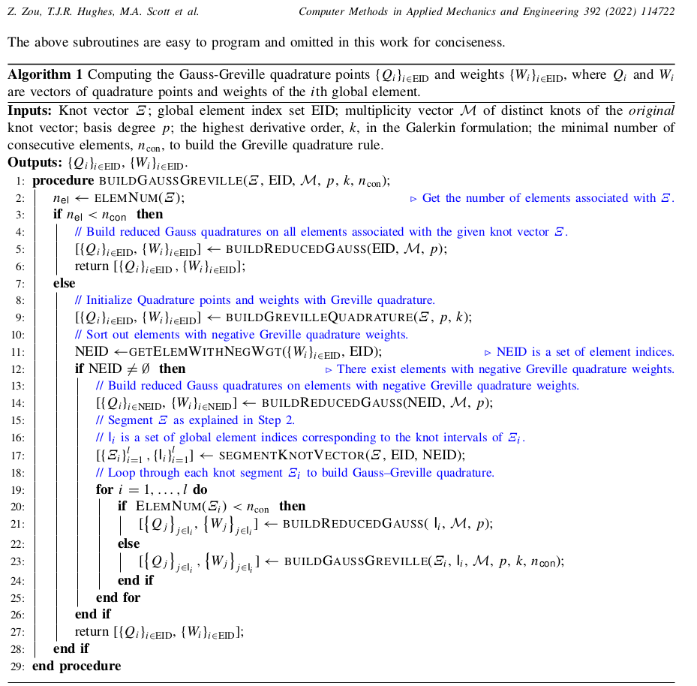
Algorithm described
in pseudo-code

Slide 6
Algorithm Description
Problem: Given the score, decide whether the student Passes or Fails the course.
Algorithm:
Natural Language
Pseudo-Code
C Program
If the student’s score is greater or equal to 60, write "Pass".
Otherwise, write "Fail".
IF score >= 60
WRITE "Pass"
ELSE
WRITE "Fail"
#include <stdio.h>
void judge(int score)
{
if(score >= 60)
puts("Pass");
else
puts("Fail");
}

Slide 7
Pseudo-Code
A combination of human language and programming language
  Mimics the syntax (语法规则) of a programming language
  Ignores implementation details
  A bridge from an idea to a program
How to write pseudocode?

Slide 8
Algorithm Analysis
Why do we need algorithm analysis?
  Once an algorithm is given for a problem and decided (somehow) to be correct, an important step is to determine how much in the way of resources, such as time or space, the algorithm will require.
  If the program is run on a large data set, then the running time becomes an issue.
  For example, an algorithm that solves a problem but requires a year is hardly of any use.

Slide 9
Algorithm Example
Problem:
Given an array, A, of n sorted values (non-decreasing order), check whether a value, x, is one of it.
Algorithm 1:
FOR EACH value IN A
IF value = x
RETURN True
RETURN False
Notes:
If the x is in A: on average (1+2+3+...+n)/n = (n+1)/2 times search.
If the x is not in A: on average n times search.
In general, the number of search is increasingly linearly with the input size.

Slide 10
Algorithm Example
Algorithm 2:
FOR EACH value IN A
IF value = x
RETURN True
ELSE IF value > x
RETURN False
RETURN False
Notes:
If x is in A: average number of search is (1+2+...+n)/n = (n+1)/2
Early stopping if x is not in the list and smaller than the maximum value in this order

Slide 11
Algorithm Example
Algorithm 3: (Binary search)
OneOf(A, l, r, x)
IF l>r
RETURN False
value = A[(l+r)/2]
IF value = x
RETURN True
ELSE IF value > x
RETURN OneOf(A, l, (l+r)/2-1, x)
ELSE
RETURN OneOf(A, (l+r)/2+1, r, x)
Notes:
If x is in A: will return true when the subarray length is reduced to 1.
T(n) = T(n/2)+1
= T(n/4)+1 + 1
= ...
= T(n/(2^k)) +k
2^k = n
k = logn
If x is not in A: will return false when the subarray length is reduced to 0 equals T(n)+1 (where x is in A).
Therefore, on average the number of times search is logn.

Slide 12
Discussion
Which algorithm is generally faster?
  Algorithm 1 or 2?
  Algorithm 2 or 3?
Describe an input instance, (A, x), such that
  Algorithm 1 is the fastest of all
  Algorithm 2 is the fastest of all
  Algorithm 3 is the fastest of all
Notes:
In general,
Algorithm 2 is better than Algorithm 1 (algorithm will terminate earlier)
Algorithm 3 is better than Algorithm 2 (every time reduce the search space by half).
Algorithm 3- in every recursion, 1(l>r)+1(value=x)+1(value>x)+2((l+r)/2)+1(A[])=6 times basic operation
Algorithm1 is the fastest of all: A={1,2,3,4,5 } , x = 5 (algorithm 1 compares 5 times, algorithm 2 compares 9 times, extra else if comparison; algorithm 3 need 3*6
Algorithm2 is the fastest of all: A={1,2,3,4,5}, x=-1 with only two comparisons; algorithm 1 need 5 comparisons; more efficient than algorithm 3
Algorithm3 is the fastest of all: A={1,2,…,63,64}, x = 64, algorithm 3: 7*6=42; for algorithm1 and algorithm2: 64, 64*2 respectively.
1-64
33-64
49-64
57-64
61-64
63-64
64 64

Slide 13
Pre-assumption for Algorithm Analysis
We only analyze correct algorithms
  Correct algorithms
    For every input instance, halt with the correct output
  Incorrect algorithms
    Might not halt at all on some input instances.
    Might halt with a wrong answer.

Slide 14
Algorithm Analysis - What
Algorithm analysis predicts the resources that an algorithm requires
  Memory (内存)
  Computational time (Efficiency)
  Communication bandwidth (通信带宽)
  Power consumption
  ......

Slide 15
Algorithm Analysis - What
Factors affecting the computational time
  Computer
  Compiler
  Algorithm used
  Input to the algorithm
    The input size (number of items in the input) affects the running time

Slide 16
Algorithm Analysis - What
Worst-case running time of an algorithm
  The longest running time for any input of size n
  An upper bound on the running time for any input of size n
  guarantee that the algorithm will never take longer time
  Example: Search a linked list for a value, and the value is at the end
Best-case running time
  The shortest running time for any input of size n
Average-case running time
  May be difficult to define what “average” means
Notes:
For average-case running time:
Average over input distributionss
Its hard to quantify what input distribution will looks like in practice.

Slide 17
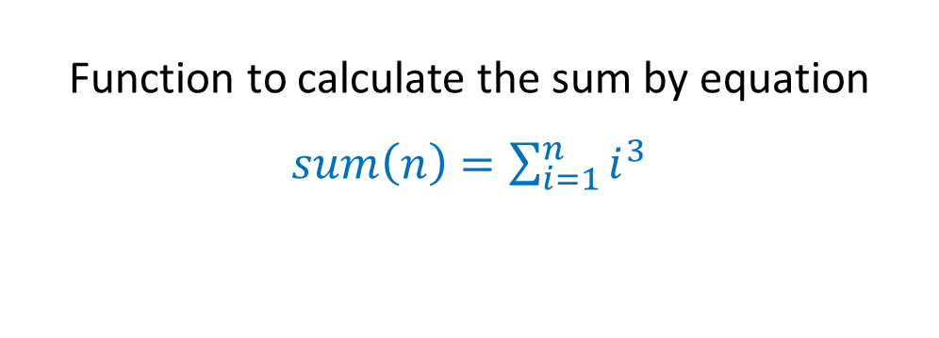
Example
int sum(int n) {
int partialSum;
partialSum = 0;
for(int i=1; i<=n; i++)
partialSum += i*i*i;
return partialSum;
}
Function to calculate the sum by equation $sum\left(n\right)=\sum_{i=1}^{n}{i^{3}}$

Slide 18
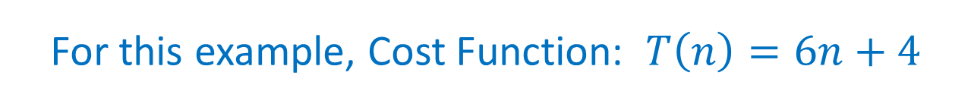
Example
How many operations are needed for this algorithm?
int sum(int n) {
int partialSum;
partialSum = 0;
for(int i=1; i<=n; i++)
partialSum += i*i*i;
return partialSum;
}
1: .……....................... 1
2: ............... 2n+2
3: ……......... 4n
4: ……................. 1
We use T(n) to denote the Cost Function with input of size n
For this example, Cost Function: $T\left(n\right)=6n+4$
Notes:
2n+2: n times increment (1, 2, ... n); (n+1) times comparision (1, 2, ..., n+1); 1 time initialization
4n: 2 times multiplication; 1 time addition; 1 time assignment

Slide 19
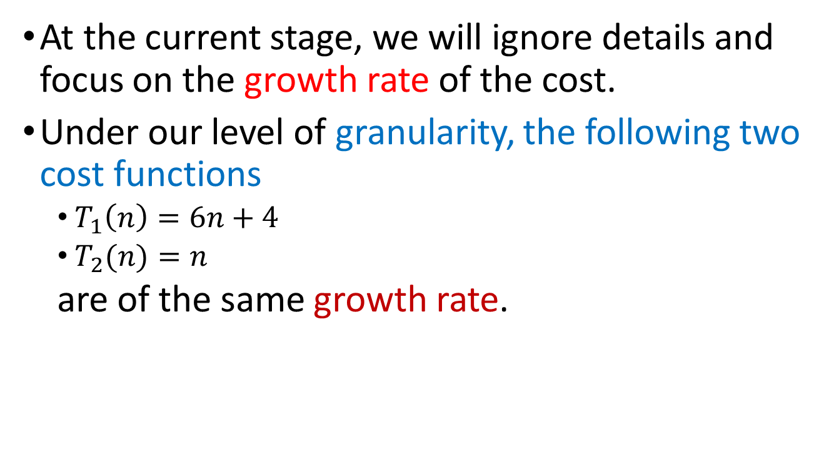
Growth Rate
At the current stage, we will ignore details and focus on the growth rate of the cost.
Under our level of granularity, the following two cost functions
  $T_{1}\left(n\right)=6n+4$
  $T_{2}(n)=n$
  are of the same growth rate.

Slide 20
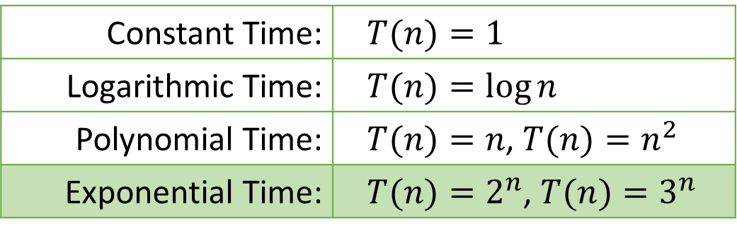
Growth Rate
Describes how fast the time cost increases as the input size n increases.
The idea is to establish a relative order (阶) among the cost functions.
Applies only for large n.
Typical Order Groups (also known as Complexity Class):
Constant Time: | $$T(n)=1$$
Logarithmic Time: | $$T(n)=\log{n}$$
Polynomial Time: | $T(n)=n$, $T(n)=n^{2}$
Exponential Time: | $T(n)=2^{n}$, $T(n)=3^{n}$
Notes:
Typical Order Groups: Exponential – non-Exponential
Polynomial time: running time not exceed the multiples of the polynomial of the input (n^k)

Slide 21
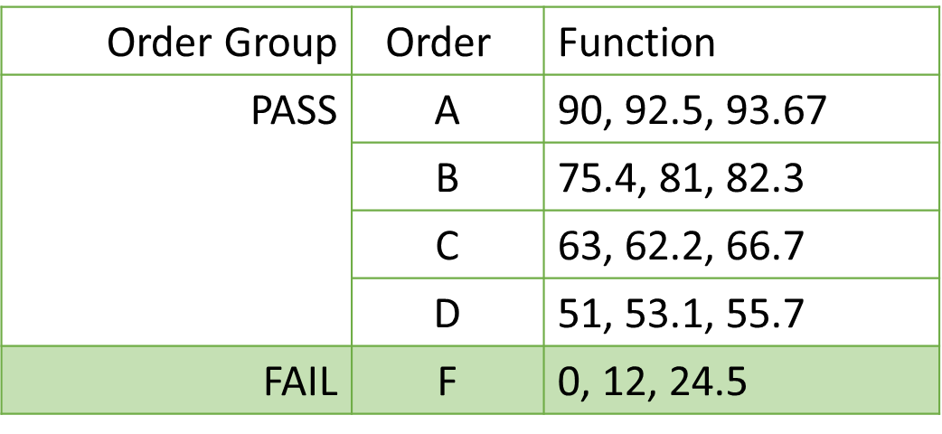
An Analogous Example
If we place these terms in our grading system …
Order Group | Order | Function
PASS | A | 90, 92.5, 93.67
 | B | 75.4, 81, 82.3
 | C | 63, 62.2, 66.7
 | D | 51, 53.1, 55.7
FAIL | F | 0, 12, 24.5

Slide 22
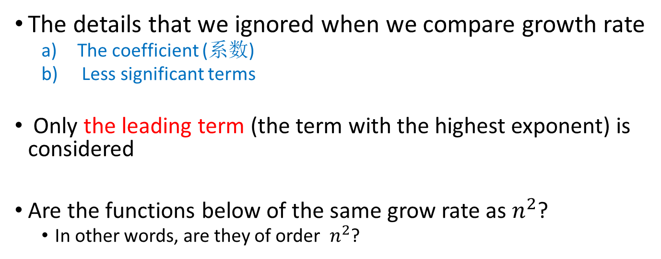
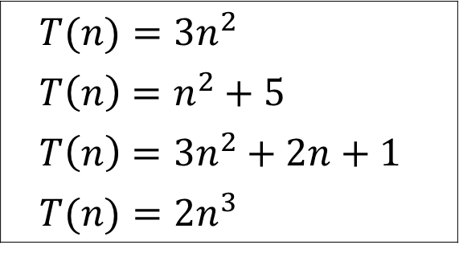
Growth Rate
The details that we ignored when we compare growth rate
  The coefficient (系数)
  Less significant terms
Only the leading term (the term with the highest exponent) is considered
Are the functions below of the same grow rate as $n^{2}$?
  In other words, are they of order $n^{2}$?
$$T(n)=3n^{2}$$
$$T\left(n\right)=n^{2}+5$$
$$T\left(n\right)=3n^{2}+2n+1$$
$$T(n)=2n^{3}$$
22
Notes:
Yes
Yes
Yes
No

Slide 23
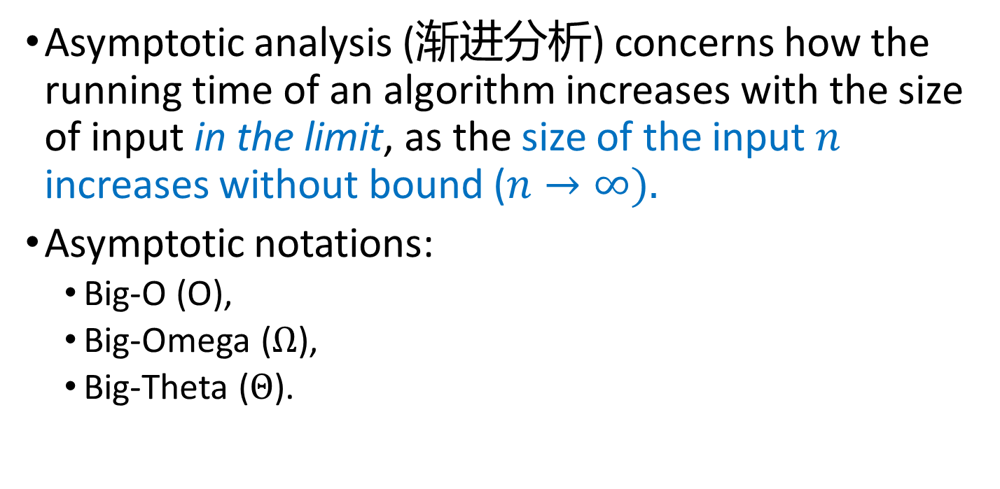
Asymptotic Analysis of algorithms
Asymptotic analysis (渐进分析) concerns how the running time of an algorithm increases with the size of input in the limit, as the size of the input $n$ increases without bound ($n→∞).$
Asymptotic notations:
  Big-O (O),
  Big-Omega ($Ω$),
  Big-Theta ($Θ$).
23

Slide 24
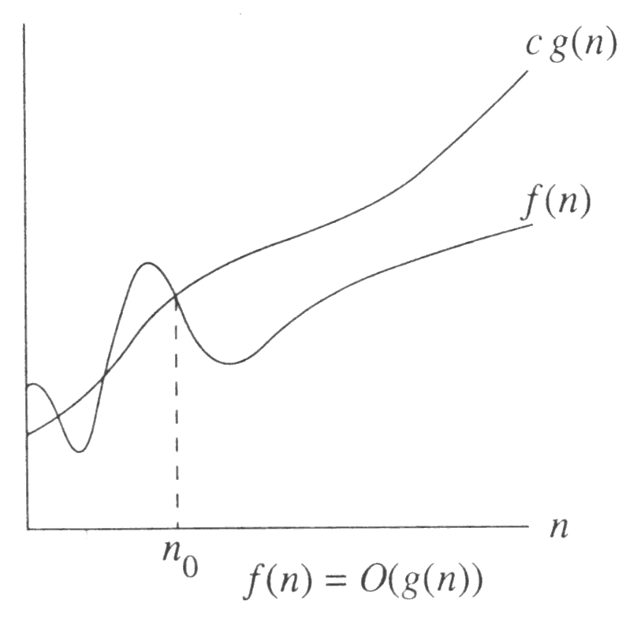
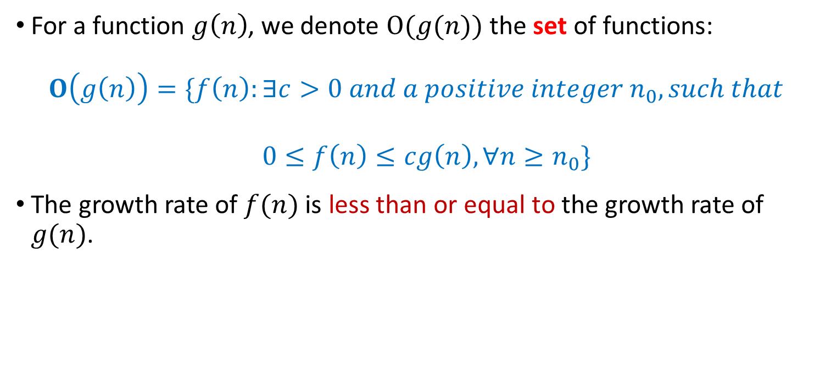
Big-O: The upper bound
For a function $g\left(n\right)$, we denote $O(g(n))$ the set of functions:
$$O\left(g\left(n\right)\right)=\{f\left(n\right):∃c>0 and a positive integer n_{0}, such that$$
$$0≤f\left(n\right)≤cg\left(n\right),∀n≥n_{0}\}$$
The growth rate of $f(n)$ is less than or equal to the growth rate of $g(n)$.
24

Slide 25

Big-O: The upper bound
$g(n)$ is an asymptotic upper bound of $f\left(n\right).$And $f(n) \text{grows} \text{no} \text{faster} \text{than} g(n) \text{for}\text{ “}\text{large}\text{” }n$.
Remark: $f\left(n\right)=O\left(g\left(n\right)\right)$ means that $f\left(n\right)$ is an element of set $O\left(g\left(n\right)\right)$.
25

Slide 26
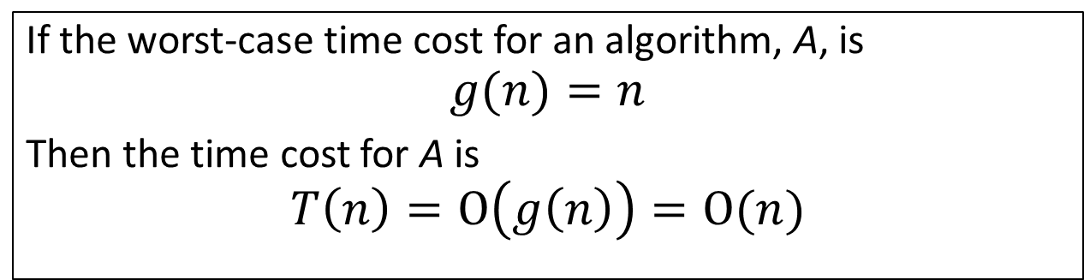
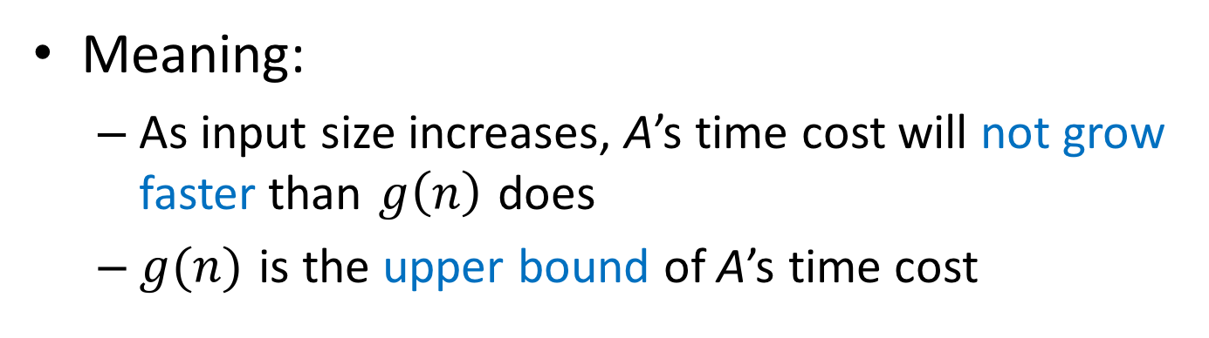
Big-O: The upper bound
If the worst-case time cost for an algorithm, A, is
$$g(n)=n$$
Then the time cost for A is
$$T\left(n\right)=O\left(g\left(n\right)\right)=O(n)$$
Meaning:
  As input size increases, A’s time cost will not grow faster than $g\left(n\right)$ does
  $g(n)$ is the upper bound of A’s time cost
26

Slide 27
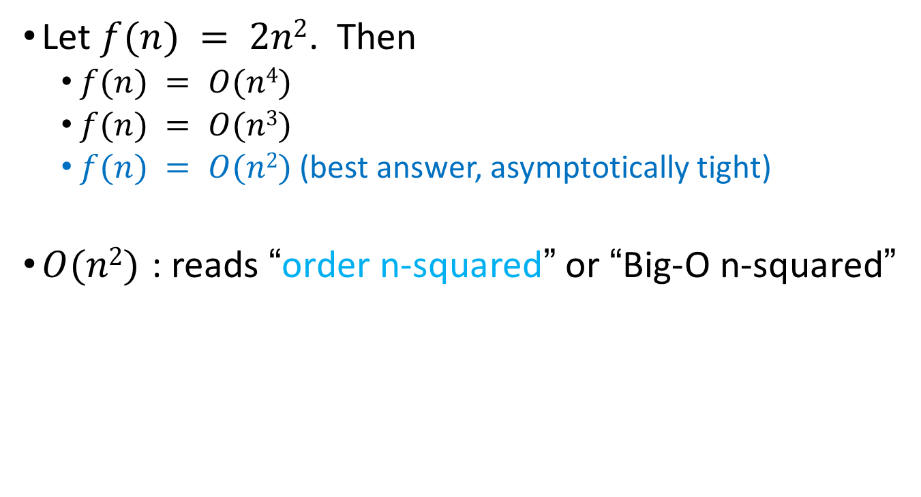
Big-O: The upper bound
Let $f(n) = 2n2$. Then
  $f(n) = O(n4)$
  $f(n) = O(n3)$
  $f(n) = O(n2)$(best answer, asymptotically tight)
$O(n2)$: reads “order n-squared” or “Big-O n-squared”
27

Slide 28
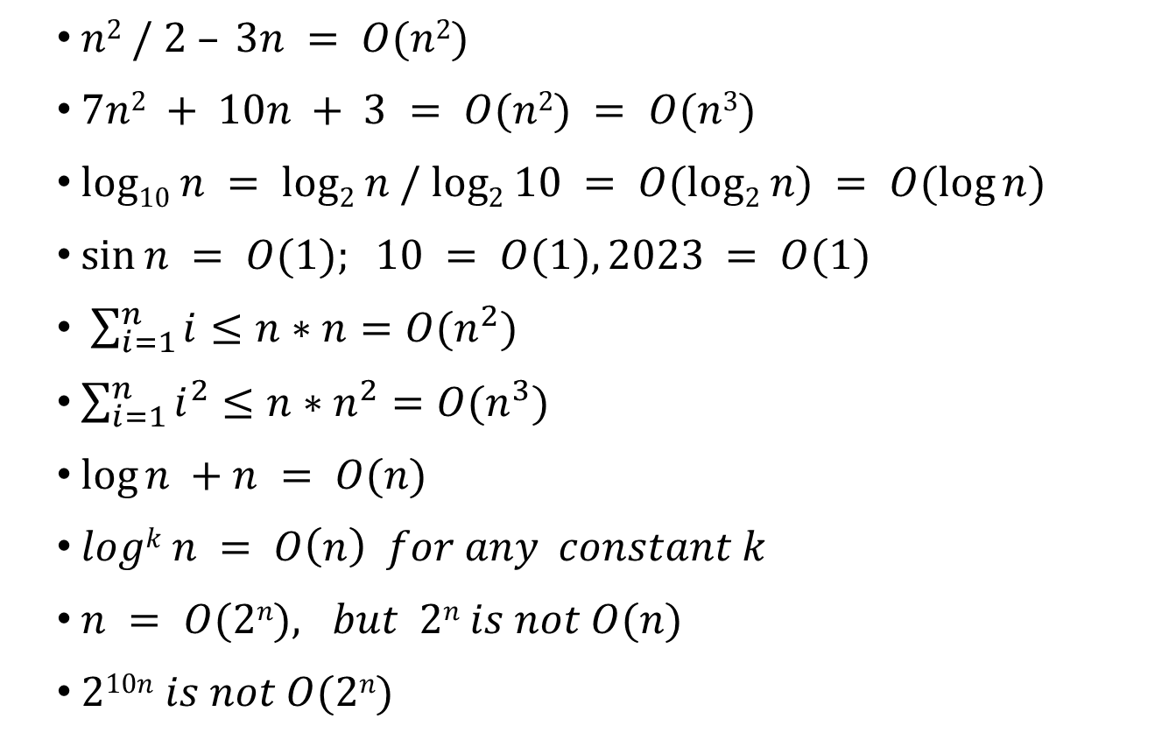
Big-O: More Examples
$n2 / 2 – 3n = O(n2)$
$7n2 + 10n + 3 = O(n2) = O(n3)$
$log10 n = log2 n / log2 10 = O(log2 n) = O(log⁡n)$
$sin⁡n = O(1); 10 = O(1), 2023 = O(1)$
$\sum_{i=1}^{n}{i}≤n∗n=O(n^{2})$
$\sum_{i=1}^{n}{i^{2}}≤n∗n^{2}=O(n^{3})$
$log⁡n +n = O(n)$
$logk n = O\left(n\right) for any constant k$
$n = O(2n), but 2n is not O(n)$
$210n is not O(2n)$
28
Notes:
𝑙𝑜𝑔𝑘 𝑛 = 𝑂(𝑛) 𝑓𝑜𝑟 𝑎𝑛𝑦 𝑐𝑜𝑛𝑠𝑡𝑎𝑛𝑡 𝑘
logn is a function with extremely slow growth. For any constant k, the multiplication of logn is still slower than polynomial time of n
Proof using L’ Hospital’s Rule

Slide 29

Math Review: logarithmic functions
$x^{a}=b iff \log_{x}{b}=a$
$log({ab)}=\log{a}+\log{b}$
$\log_{a}{b}=\frac{\log_{m}{b}}{\log_{m}{a}}$
$\log{a^{b}}=b\log{a}$
$a^{\log{n}}=n^{\log{a}}$
$\log^{b}a={(\log{a})}^{b}$
$\frac{d\log_{e}{x}}{dx}=\frac{1}{x}$
29
Notes:
a ^ logn = t
Logn =log_a t
N = 2^(log_a t)
N^loga = 2^(log_a t) ^loga= 2^loga ^ log_a t= a ^ log_a t = t

Slide 30
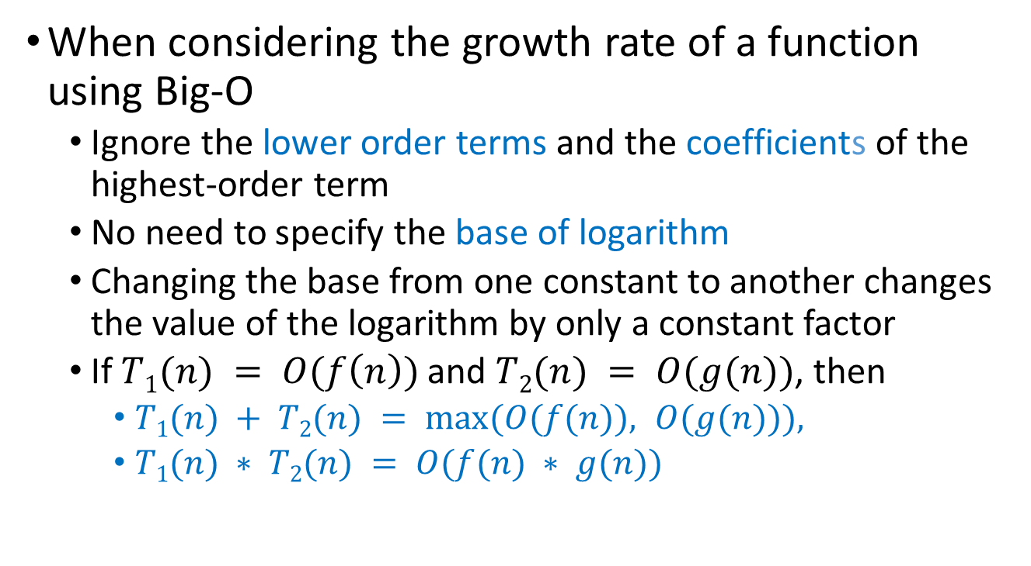
Some Rules
When considering the growth rate of a function using Big-O
  Ignore the lower order terms and the coefficients of the highest-order term
  No need to specify the base of logarithm
  Changing the base from one constant to another changes the value of the logarithm by only a constant factor
  If $T1(n) = O(f\left(n\right))$and $T2(n) = O(g(n))$, then
    $T1(n) + T2(n) = max⁡(O(f(n)), O(g(n))),$
    $T1(n) ∗ T2(n) = O(f(n) ∗ g(n))$

Slide 31

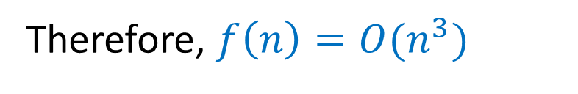
Application of the Rules
$$f\left(n\right)=5n^{3}+4n^{2}+3\log{n}$$
Coefficient
Lower Order Term
Lower Order Term
Therefore, $f\left(n\right)=O(n^{3})$

Slide 32
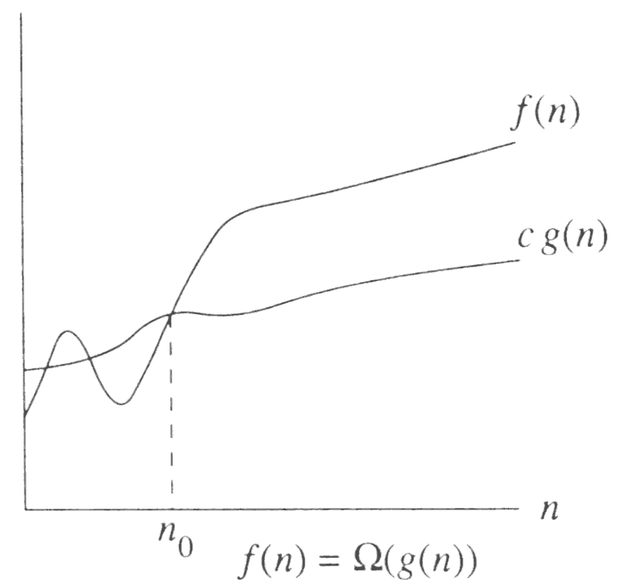
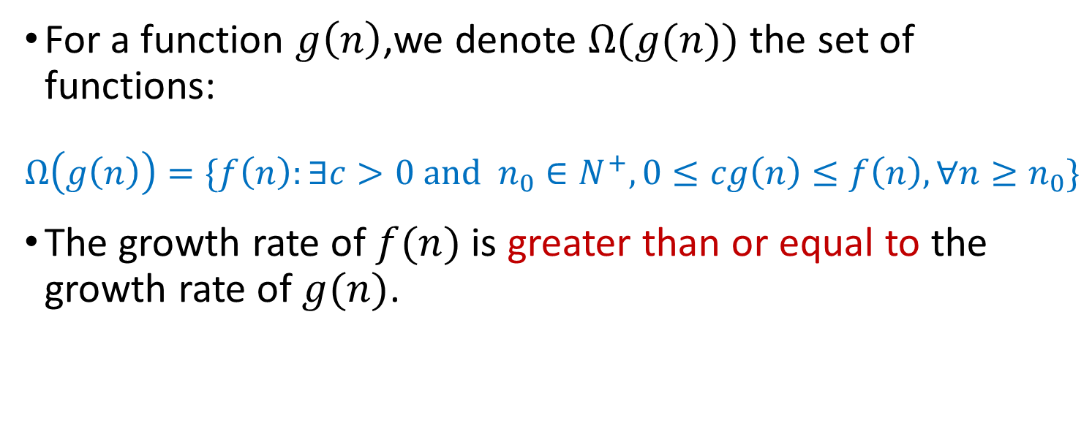
Big-Omega: The Lower Bound
For a function $g\left(n\right)$,we denote $Ω(g(n))$ the set of functions:
$$Ω\left(g\left(n\right)\right)=\{f\left(n\right):∃c>0 and n_{0}∈N^{+}, 0≤cg\left(n\right)≤f\left(n\right),∀n≥n_{0}\}$$
The growth rate of $f(n)$ is greater than or equal to the growth rate of $g(n)$.

Slide 33
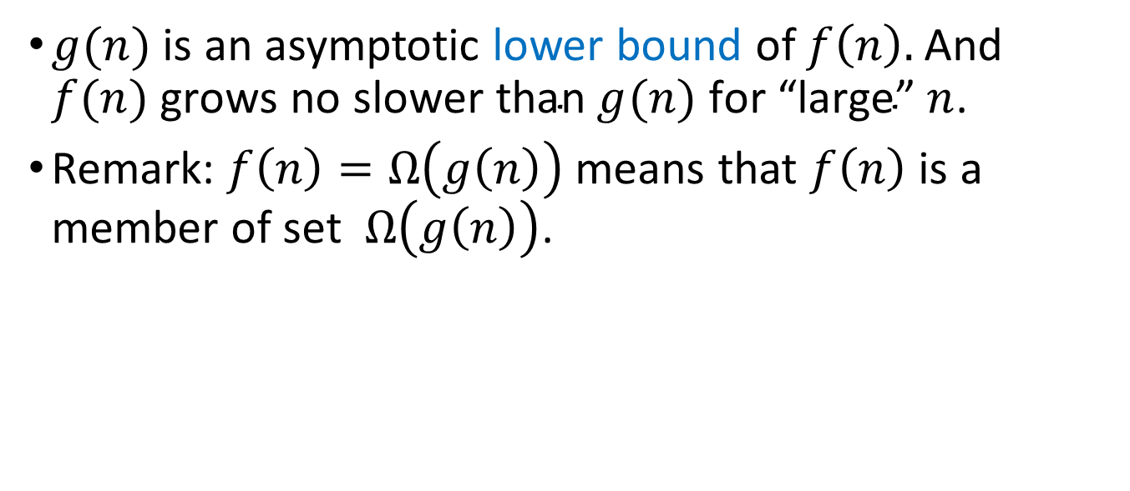
Big-Omega: The Lower Bound
$g(n)$ is an asymptotic lower bound of $f\left(n\right).$And $f(n) \text{grows} \text{no} \text{slower} \text{than} g(n) \text{for}\text{ “}\text{large}\text{” }n$.
Remark: $f\left(n\right)=Ω\left(g\left(n\right)\right)$ means that $f\left(n\right)$ is a member of set $Ω\left(g\left(n\right)\right)$.

Slide 34
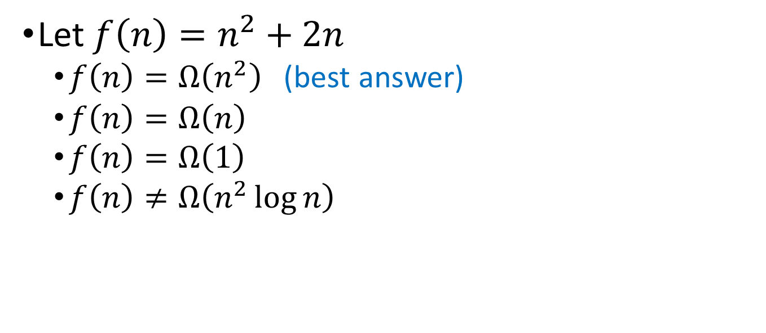
Big-Omega: The Lower Bound
Let $f\left(n\right)=n^{2}+2n$
  $f\left(n\right)=Ω\left(n^{2}\right)$ (best answer)
  $f\left(n\right)=Ω\left(n\right)$
  $f\left(n\right)=Ω\left(1\right)$
  $f\left(n\right)≠Ω\left(n^{2}\log{n}\right)$

Slide 35
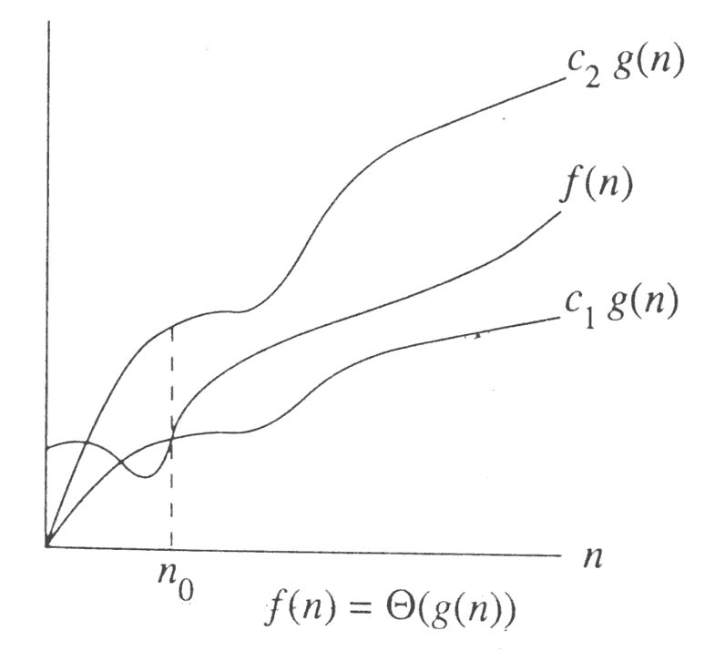
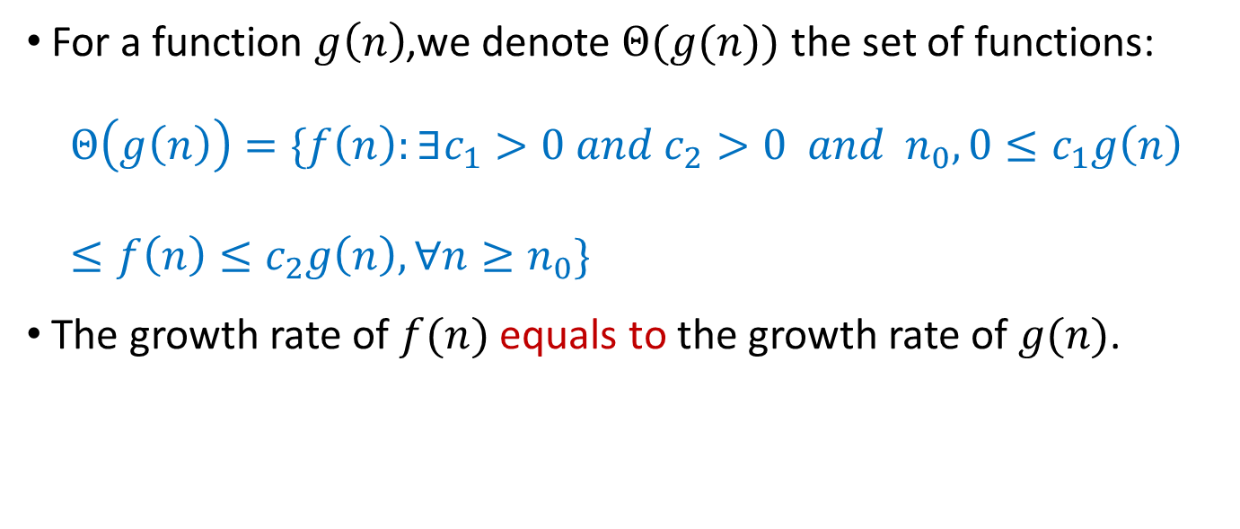
Big-Theta: Tight Bound
For a function $g\left(n\right)$,we denote $Θ(g(n))$ the set of functions:
$$Θ\left(g\left(n\right)\right)=\{f\left(n\right):∃c_{1}>0 and c_{2}>0 and{ n}_{0}, 0≤c_{1}g\left(n\right)≤f\left(n\right)≤c_{2}g\left(n\right),∀n≥n_{0}\}$$
The growth rate of $f(n)$ equals to the growth rate of $g(n)$.

Slide 36

Big-Theta: Tight Bound
$g(n)$ is an asymptotic tight bound of $f\left(n\right)$.
Remark: $f\left(n\right)=Θ\left(g\left(n\right)\right)$ means that $f\left(n\right)$ is a member of set $Θ\left(g\left(n\right)\right)$.

Slide 37
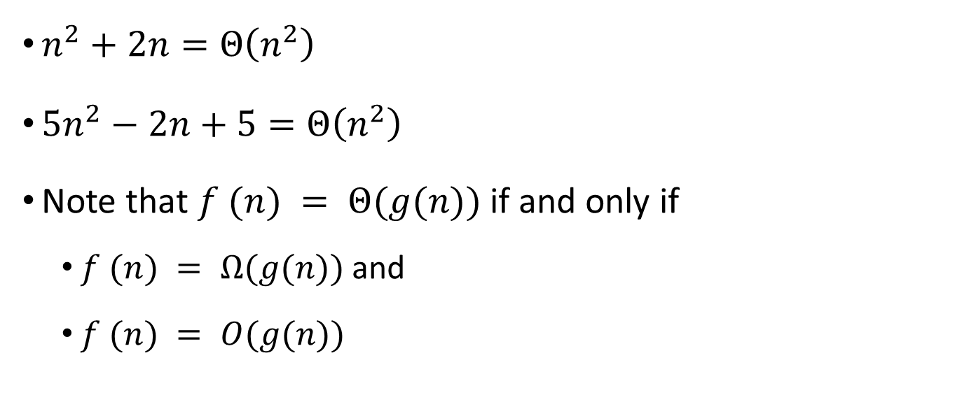
Big-Theta: Tight Bound
$n^{2}+2n=Θ\left(n^{2}\right)$
${5n}^{2}−2n+5=Θ\left(n^{2}\right)$
Note that $f (n) = Θ(g(n))$if and only if
  $f (n) = Ω(g(n))$and
  $f (n) = O(g(n))$

Slide 38
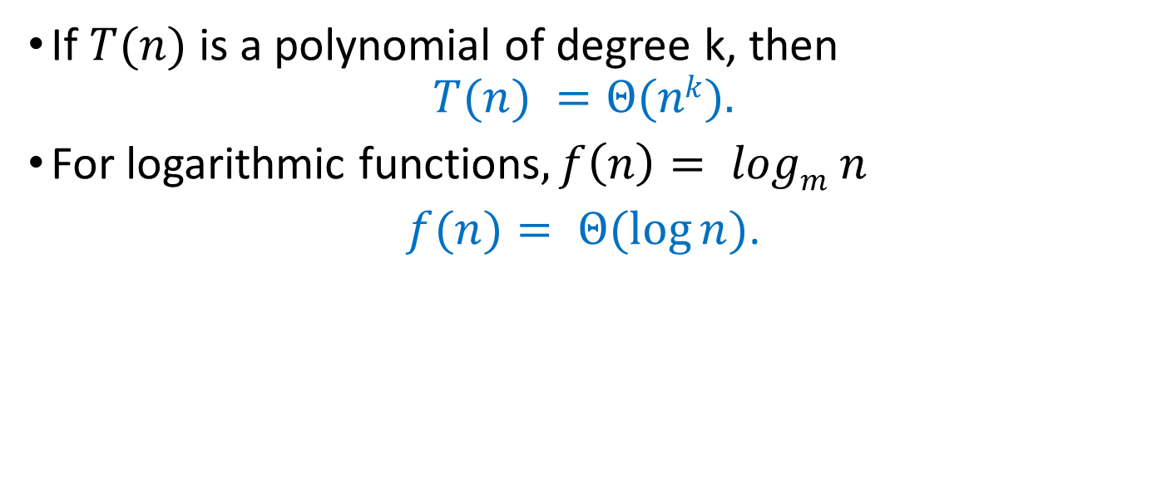
Some Rules
If $T(n)$ is a polynomial of degree k, then
$$T(n) =Θ(nk).$$
For logarithmic functions$, f\left(n\right)= logm n$
$f(n)= Θ(log⁡n)$.

Slide 39
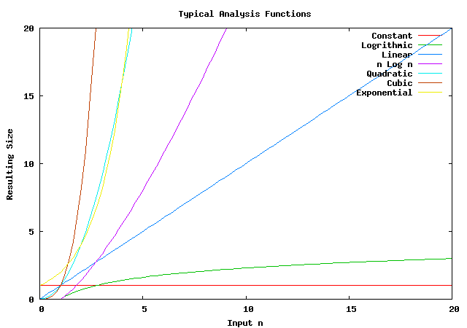
Typical Growth Rates
Notes:
Polynomial Order Group: constant order, logarithm order, linear order, n-squared, n-cubic, n to the power of K
Non-polynomial Order Group: - Exponential Order； Factorial Order
2^x will larger than x^3 when x=10

Slide 40
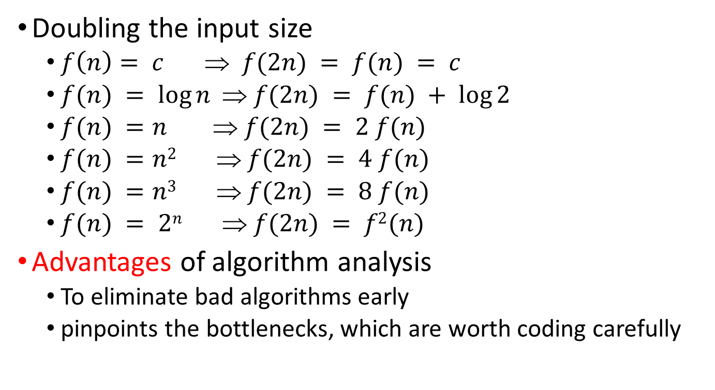
Growth rates …
Doubling the input size
  $f\left(n\right)= c ⇒ f(2n) = f(n) = c$
  $f(n) = log⁡n  f(2n) = f(n) + log⁡2$
  $f(n) =n  f(2n) = 2 f(n)$
  $f(n) =n2  f(2n) = 4 f(n)$
  $f(n) =n3  f(2n) = 8 f(n)$
  $f(n) = 2n  f(2n) = f2(n)$
Advantages of algorithm analysis
  To eliminate bad algorithms early
  pinpoints the bottlenecks, which are worth coding carefully

Slide 41
Visualization
Visualization and Comparison of Sorting Algorithms
Algorithms used:
Selection Sort | Shell Sort | Insertion Sort
Merge Sort | Quick Sort | Heap Sort
Bubble Sort | Comb Sort | Cocktail Sort
Notes:
Selection sort: 每次选最小的放到第一个位置；重复； 不稳定排序算法(相等元素经过排列后序列保持不变)：比较次数 n(n-1)/2; 交换次数 0 – n-1次之间
Shell sort: 插入排序的变种，先取一个小于n的整数d1作为第一个增量，把文件的全部记录分组。所有距离为d1的倍数的记录放在同一个组中。先在各组内进行直接插入排序；然后，取第二个增量d2<d1重复上述的分组和排序，直至所取的增量 =1(< …<d2<d1)，即所有记录放在同一组中进行直接插入排序为止。
Insertion sort: insert elements in a partial sorted array
Merge sort: merge to sorted sort
Quick sort: pivot
Heap sort: using heap
Bubble sort: 每次把最大元素放到最右侧
Comb sort: variation of bubble, start with larger gap and reduce to 1 （梳排序）
Cocktail sort: variation of bubble, bi-directional search of bubble sort

Slide 42

Using L' Hopital's rule
L' Hopital's rule
  If $\lim_{n→∞}{f\left(n\right)=∞}$ and $\lim_{n→∞}{g\left(n\right)=∞}$
  then $\lim_{n→∞}{\frac{f(n)}{g(n)}=\lim_{n→∞}{\frac{f^{′}(n) }{g^{′}(n)}}}$
Determine the relative growth rates (using L' Hopital's rule if necessary)
  compute $\lim_{n→∞}{\frac{f(n)}{g(n)}}$
  if 0: $f(n) = O(g(n))$and $f\left(n\right)is not Θ(g(n))$
  if constant ≠ 0: $f(n) = (g(n))$
  if ∞: $f(n) = (g(n))$and $f(n)$ is not $(g(n))$
  limit oscillates: no relation

Slide 43
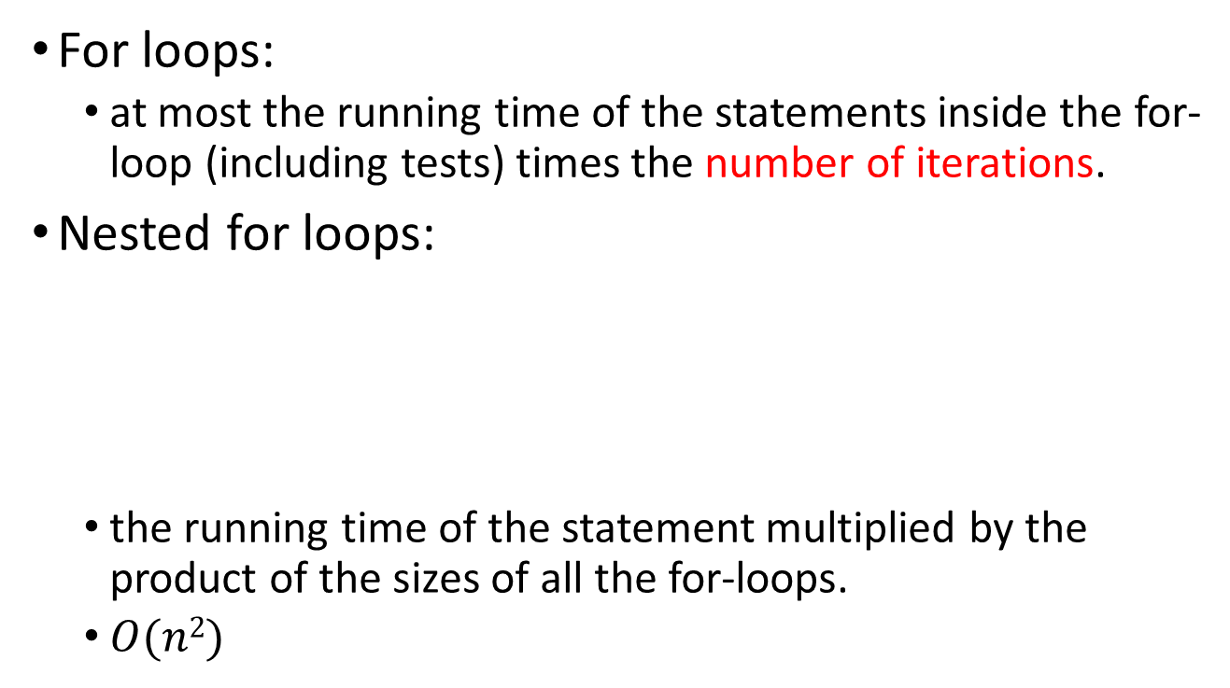
How to determine growth rate
For loops:
  at most the running time of the statements inside the for-loop (including tests) times the number of iterations.
Nested for loops:
  the running time of the statement multiplied by the product of the sizes of all the for-loops.
  $O(n2)$
for(int i=0; i<n; i++)
for(int j=0; j<n; j++)
k++;

Slide 44

How to determine growth rate
Consecutive statements:
  Just add the running time
  $O(n) + O(n2) = O(n2)$
For If S1 Else S2
  never more than the running time of the test plus the larger of the running times of S1 and S2.
for(int i=0; i<n; i++)
k++;
for(int i=0; i<n; i++)
for(int j=0; j<n; j++)
k++;

Slide 45
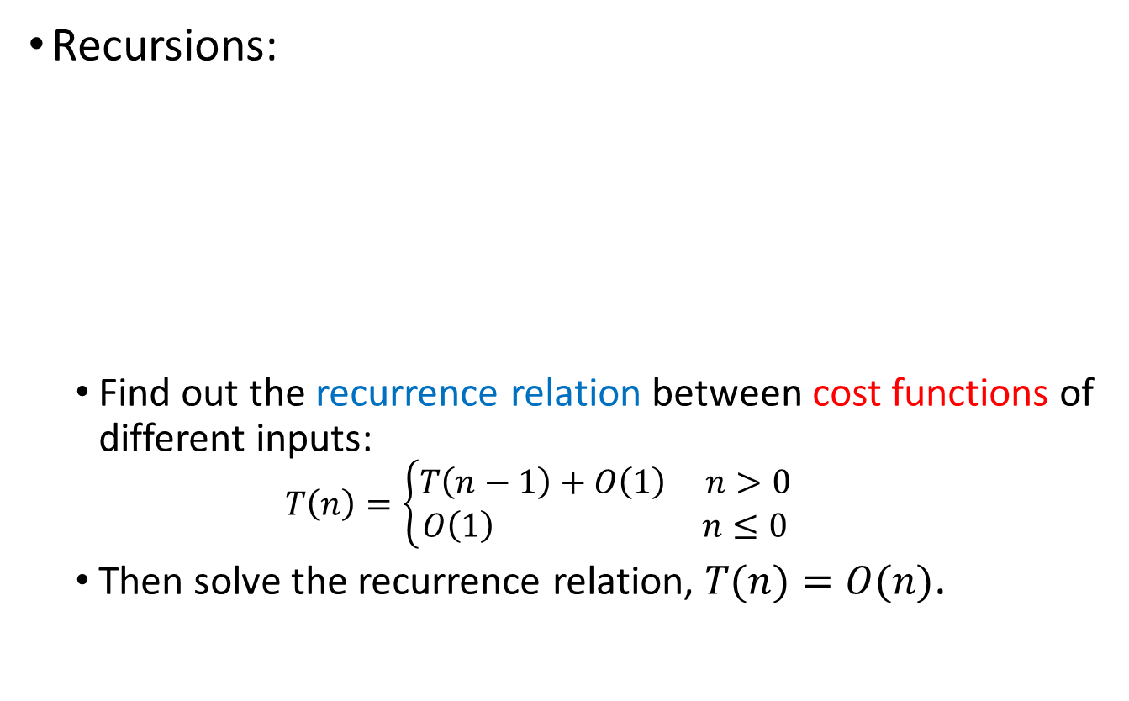
How to determine growth rate
Recursions:
  Find out the recurrence relation between cost functions of different inputs:
  $$T\left(n\right)=\left\{\begin{aligned}T\left(n−1\right)+O\left(1\right) n>0 \\ O\left(1\right) n≤0\end{aligned}\right.$$
  Then solve the recurrence relation, $T(n)=O(n)$.
int sum(int n) {
if(n<=0)
return 0;
return n + sum(n-1);
}

Slide 46

Solving Recurrence Relation
Let $T\left(n\right)=\left\{\begin{aligned}T\left(n−1\right)+O\left(1\right) n>0 \\ O\left(1\right) n≤0\end{aligned}\right.$
Then,
$$T\left(n\right) = T\left(n−1\right)+ O\left(1\right)$$
$= T\left(n−1\right)+ 1$
$= T\left(n−2\right)+ 1 + 1 = T\left(n−2\right)+ 2$
$= T\left(n−3\right)+ 3$
$= T\left(n−i\right)+ i$
$=…$
$= T\left(n−n\right)+ n$
$= T\left(0\right)+ n$
$= O(n)$

Slide 47
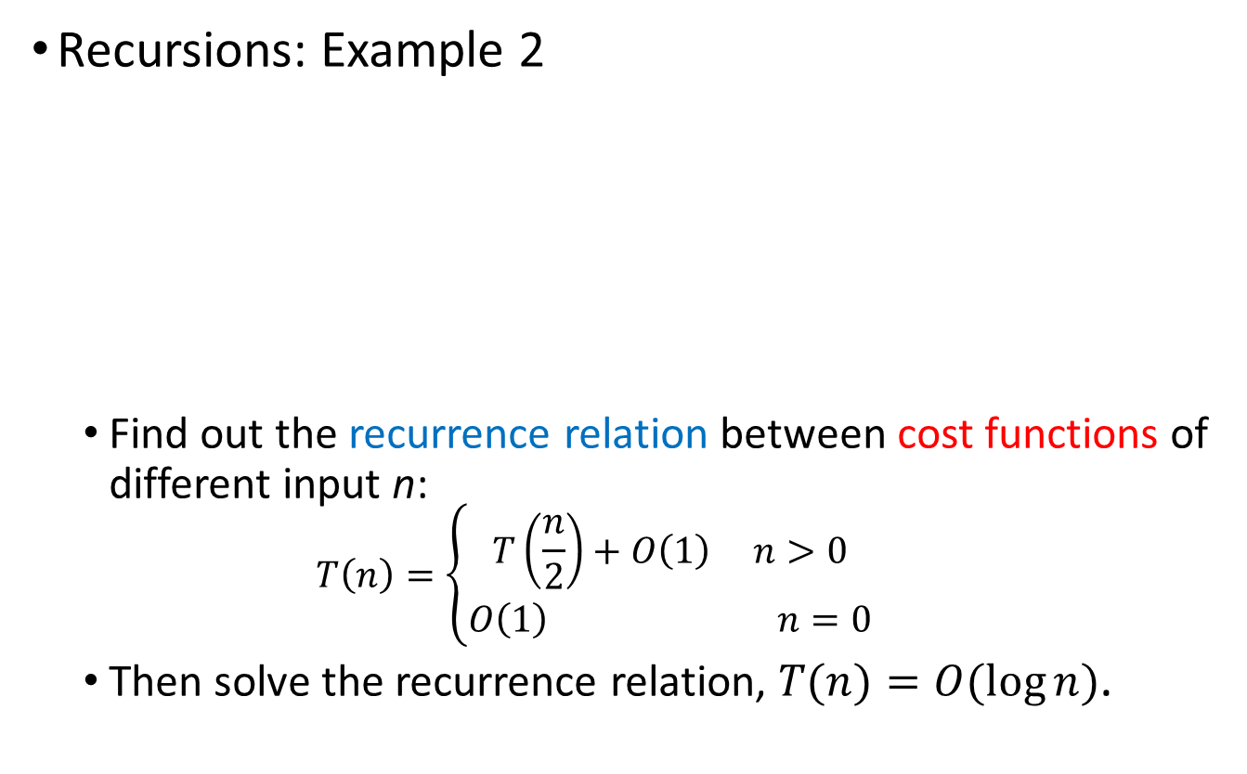
How to determine growth rate
Recursions: Example 2
  Find out the recurrence relation between cost functions of different input n:
  $$T\left(n\right)=\left\{\begin{aligned}T\left(\frac{n}{2}\right)+O\left(1\right) n>0 \\ O\left(1\right) n=0\end{aligned}\right.$$
  Then solve the recurrence relation, $T(n)=O(\log{n})$.
int fac(int n) {
if(n<=0)
return 1;
return n + fac(n/2);
}

Slide 48
